Slide 2
Forward-Looking
Statements
This presentation contains forward-looking statements that relate to future events or our future financial performance and involve known and unknown risks, uncertainties and other factors that may cause our, or our industry’s, actual results, levels of activity, performance or achievements to be materially different from any future results, levels of activity, performance or achievements expressed, implied or inferred by these forward-looking statements. Such risks and uncertainties include, but are not limited to, its ability to conduct a go public transaction, including not not limited to a Reverse Take Over (RTO) and the risk of liability being imposed under the laws in which EWS operates, negative changes in the political environment or in the regulation of EWS’s business in Canada; negative shifts in public opinion and perception of the consumer credit and protection regulations; risk of shortages of or price increases in key inputs, suppliers and skilled labor; loss of intellectual property rights or protections; cybersecurity risks; constraints on marketing products; fraudulent activity by employees, contractors and consultants; tax and insurance related risks and risk of litigation.
These factors should be considered carefully and readers are cautioned not to place undue reliance on such forward-looking statements. The forward-looking statements are based upon management’s beliefs and assumptions and are made as of the date of this presentation. In light of the significant uncertainties inherent to the forward-looking statements included in this presentation, the inclusion of such information should not be regarded as a representation or warranty by us or any other person that our objectives and plans will be achieved in any specified time frame, if at all.
You should not place undue reliance on these forward-looking statements. Except to the extent required by applicable laws or rules, we undertake no obligation to update or revise any forward-looking statements included in this presentation.

Slide 3
Disclaimer
General
The information contained in this presentation has been prepared by Emergent Waste Solutions Inc. (“EWS”) in connection with the offer and sale of securities of EWS on a private placement basis. This presentation contains information pertaining to the business, operations and assets of EWS. The information contained in this presentation (a) is provided as at the date hereof and is subject to change without notice, (b) does not purport to contain all the information that may be necessary or desirable to fully and accurately evaluate an investment in EWS, and (c) is not to be considered as a recommendation by EWS to purchase any securities offered in connection with this presentation. An investment in such securities is speculative and involves a number of risks that should be considered by a prospective investor.
All information and data provided in this presentation is strictly private and confidential. No person is authorized to copy or re-distribute any materials in this presentation without the express permission of EWS.
This presentation constitutes an “offering memorandum” under applicable securities laws (including pursuant to the Securities Act (Ontario) and OSC Rule 45-501 Ontario Prospectus and Registration Exemptions). See “Statutory Rights of Rescission – Ontario Investors” at the end of this presentation for further information.
Prospective investors should be aware that the purchase of the securities may have tax consequences both in Canada and the United States. Each prospective investor should consult its own tax advisor concerning the investment described herein.
Market And Industry Data
This presentation includes market and industry data that has been obtained from third- party sources, including industry publications. EWS believes that the industry data is accurate and that its estimates and assumptions are reasonable, but there is no assurance as to the accuracy or completeness of this data. Third party sources generally state that the information contained therein has been obtained from sources believed to be reliable, but there is no assurance as to the accuracy or completeness of included information. Although the data is believed to be reliable, EWS has not independently verified any of the data from third-party sources referred to in this presentation or ascertained the underlying economic assumptions relied upon by such sources.

Slide 4
OUR MISSION
Emergent Waste Solutions converts waste carbon into valuable carbon, oil and gas products through its ATS technology. We make waste profitable™
IT MANAGEMENT
IT DESIGN
DATA SECURITY

Slide 5
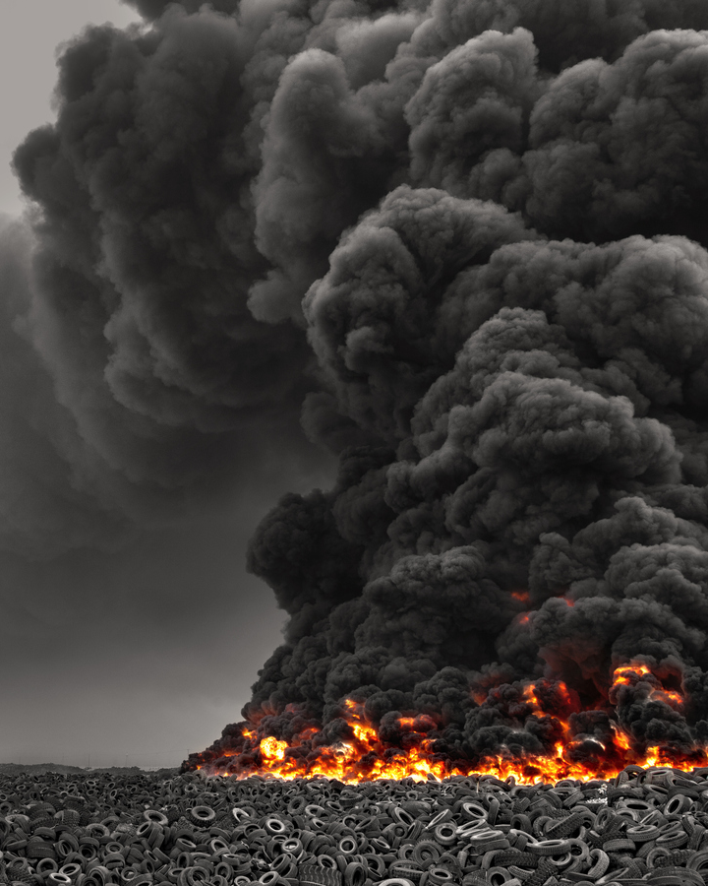
WASTE
The Opportunity & The Solution
The traditional Waste Treatment and Disposal Service industry in Canada alone is $5.1 billion in 2022.
Emergent Waste Solutions brings its truly disruptive Advanced Thermolysis System (ATS)* technology.
* Patent Pending

Slide 6
INTRODUCING THERMOLYSIS
Near Zero Emissions
Thermolysis takes place when waste carbon is subjected to a very high temperature in the absence of oxygen. Without oxygen, combustion cannot take place. Instead the substance is broken down into renewable natural gas, oil products and biocarbon.
Solution for local landfills
Valuable products
SUPERIOR TO INCINERATION

Slide 7
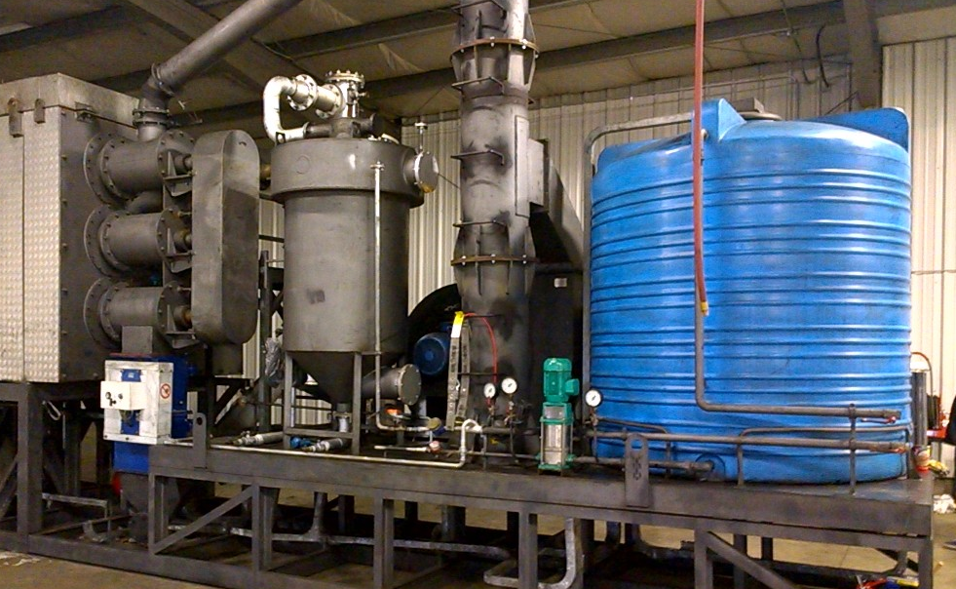
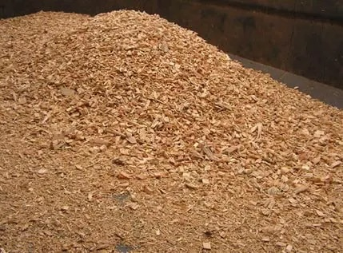
d
Bio-oil
Biochar
Renewable natural gas
Emergent Waste Solutions
Generating valuable energy and products from Waste
World-leading Thermolysis Technology. Patent pending.
Initial Plant in Operation
Production and sales of Biochar during ramp-up
Wood Waste
*RNG: Renewable Natural Gas. MSW: Municipal Solid Waste

Slide 8
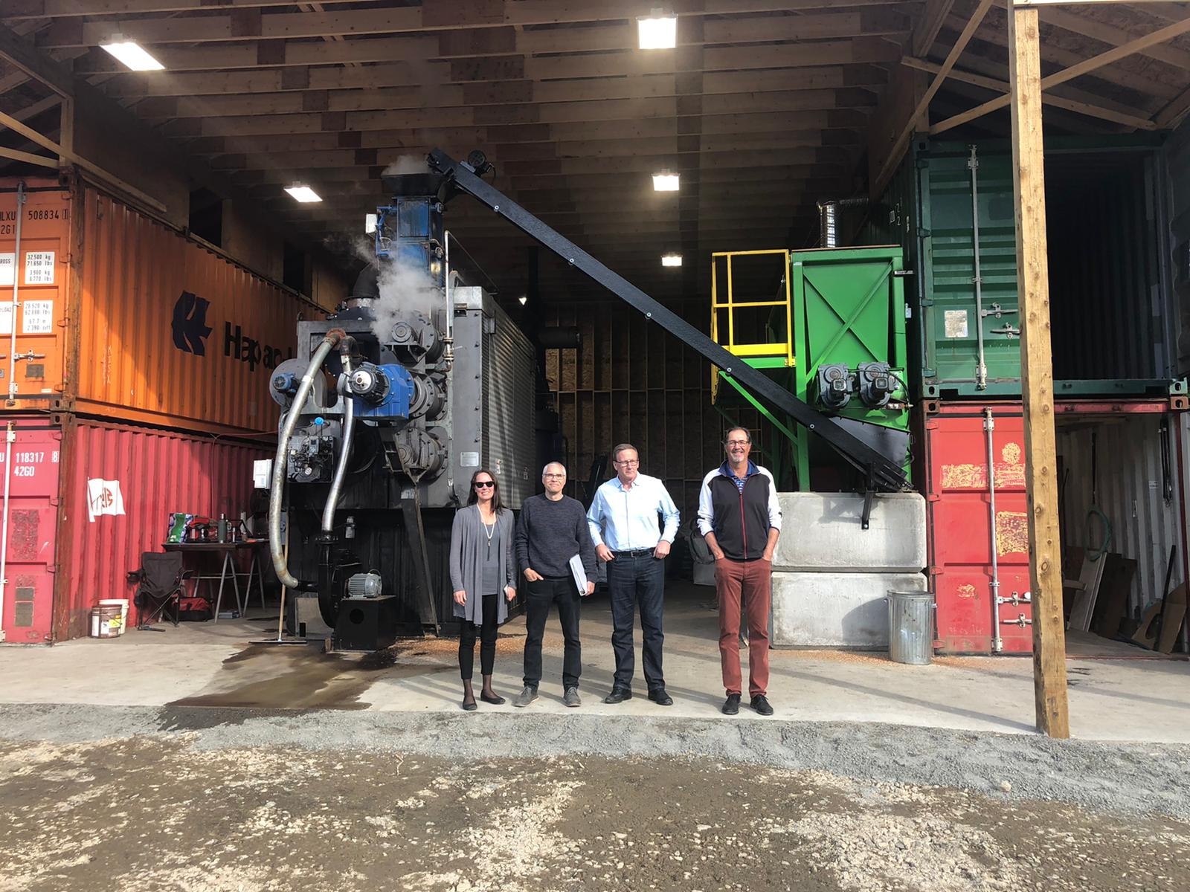
Revenue Model from Existing Commercial Plant (43% revenue stream)
$1.01 MM Gross Revenue
$241,210 Operating Expenses & COGS
$768,790 EBITDA

Slide 9
Global Revenue Models
100% Ownership
Debt, Project Financing, or Government Grants
Sale of a Plant
Gross Profit $2.5 - 10 MM
Joint Venture
50% of ongoing Revenue
Manage Plant

Slide 10
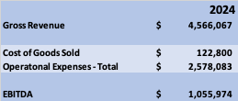
Forecast Growth
2024: Three plants under development (one sold)

Slide 11
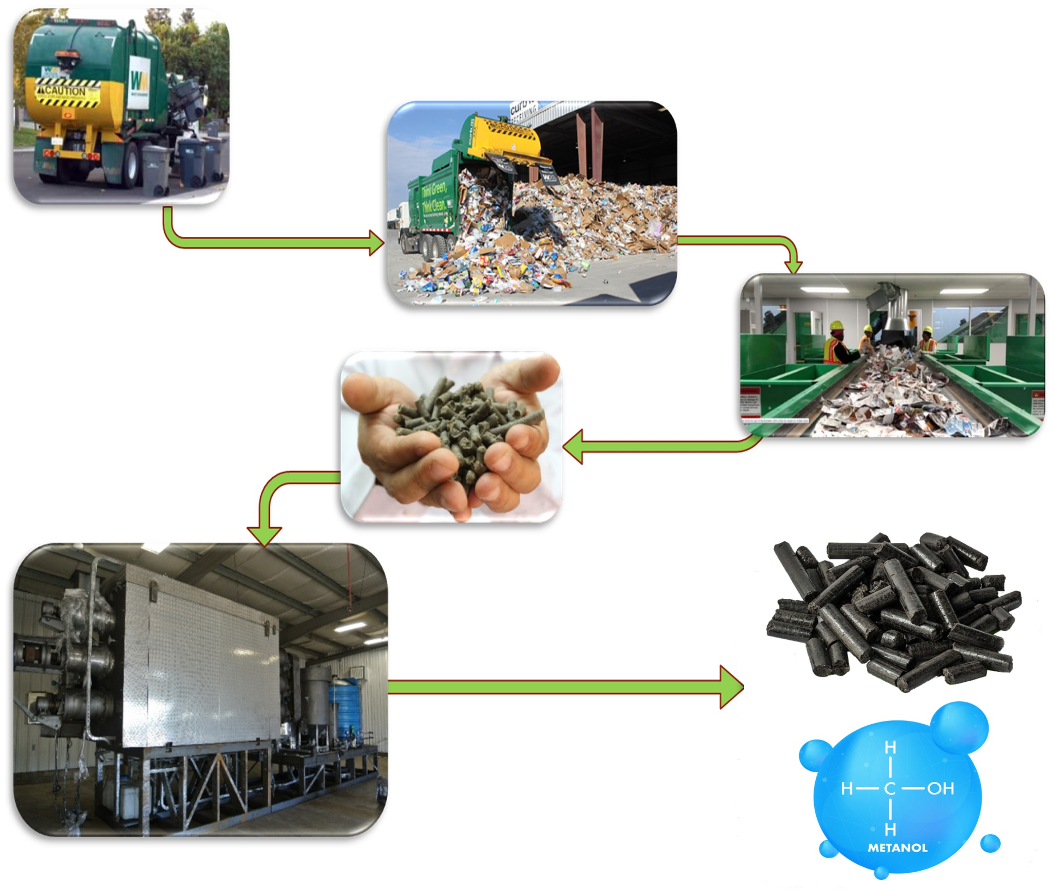
WASTE IS TAKEN TO CENTRAL PROCESSING CENTER
NON-CARBON AND ORGANIC MATERIAL IS REMOVED
HOME-OWNERS REMOVE METAL & GLASS
OUR PROCESS
PROFITABLE
SUSTAINABLE
SCALABLE
GLOBAL
REFUSE DERIVED FUEL (RDF) PELLETS ARE CREATED
BIO-COAL IS CREATED
METHANOL IS CREATED
PELLETS ARE TORREFIED BY THE ATS PLANT

Slide 12
Potential Canadian Market
By Waste Stream
Waste Stream | Plants Required to Process Waste Stream | Tonnes of CO2 Potentially Saved *
Livestock Manure | 644 | 6,694,380
Municipal Sewage Sludge | 143 | 1,486,485
Used Rubber Tires | 23 | 358,628
Recycled Plastic | 110 | 1,588,125
Municipal Solid Waste | 784 | 4,980,360
Pulp Mills | 114 | 1,580,040
Waste Wood Biomass | 1,734 | 24,033,240
Total | 3,552 | 40,721,258
* Source: http://www.engineeringtoolbox.com/co2-emission-fuels-d_1085.html | http://www.ieabioenergy.com

Slide 13
PROFIT POTENTIAL
FOR ATS5000
Municipal Solid Waste (MSW) – ATS4000 | Municipal Solid Waste (MSW) - AATS5000 | Municipal Solid Waste (MSW) - AATS5000 | Municipal Solid Waste (MSW) - AATS5000 | Municipal Solid Waste (MSW) - AATS5000
Manufactured Product | % of Output | Tonnes of Annual Output | Price Per Tonne | Revenue
Bio Oil | 8% | 4,356 | $400 | $3,801,600
Bio-Coal | 70% | 38,115 | $1,500 | $12,117,600
Methanol | 14% | 7,732 | $365 | $2,822,144
Other gasses | 8% | - | - | -
Tipping Fee |  |  | $100 | $2,376,000
Total Revenue |  |  |  | $48,124,544
Approx. Operational Expenses |  |  |  | $9,743,252
Royalty |  |  |  | $2,406,227
Operating Income |  |  |  | $35,975,064
Notes: •Based on 165 Tonnes Per Day for 330 Operating Days Per Year •All figures are shown in US Dollars •Chart assumes a Canadian market •The Methane is expected to have a local market, this proforma will be adjusted as the market is researched | Notes: •Based on 72 Tonnes Per Day for 330 Operating Days Per Year •All figures are shown in Canadian Dollars •Chart assumes a Canadian setting •Additional by-products may be produced that would both generate power and heat for the plant, and potentially produce additional revenue. | Notes: •Based on 72 Tonnes Per Day for 330 Operating Days Per Year •All figures are shown in Canadian Dollars •Chart assumes a Canadian setting •Additional by-products may be produced that would both generate power and heat for the plant, and potentially produce additional revenue. | Notes: •Based on 72 Tonnes Per Day for 330 Operating Days Per Year •All figures are shown in Canadian Dollars •Chart assumes a Canadian setting •Additional by-products may be produced that would both generate power and heat for the plant, and potentially produce additional revenue. | Notes: •Based on 72 Tonnes Per Day for 330 Operating Days Per Year •All figures are shown in Canadian Dollars •Chart assumes a Canadian setting •Additional by-products may be produced that would both generate power and heat for the plant, and potentially produce additional revenue.
MUNICIPAL
SOLID WASTE

Slide 14
14
Management Team
Kevin Hull BBA, CEO, Director
Kevin, founder of Emergent Waste Solutions, brings extensive experience in mining, environmental technologies, sales roles in IT and marketing expertise. Before founding EWS, he was active in capital markets. He was instrumental in securing $20 MM USD from a state-owned Chinese enterprise into a Canadian junior resource company on the TSXV. Previously he consulted companies and developed marketing strategies and content. Along with his extensive sales training, Kevin holds a degree in Business Administration.
Brian Gusko Director, VP Finance
With over 15 years of experience in capital markets, Brian has helped raise over $50 MM for various firms. He has served on the Board of at least 10 public companies and served as CEO and CFO for several public companies.
The last company he took public became Biome Grow Inc, which upon listing was valued at over $200 MM
Dan Becher Director
Dan graduated with a diploma in Instrumentation & control systems from British Columbia Institute of Technology. He has worked in industrial chemical plants for 37 years in varied capacities of engineering design & maintenance of both process control & electrical systems. His experience brings practical value to EWS in plant operations, maintenance & design enhancements.

Slide 15
COMPARATIVE ANALYSIS WITH INDUSTRY PEERS
COMPARISON WITH YES.CSE
COMPARABLE $17K REVENUE IN THE LAST QUARTER.
COMPARISON WITH ECM.V:
$81,632 “ANCILLARY REVENUE”.
COMPARISON WITH ACT:CSE
FAVORABLE COMPARISON IN TERMS OF REVENUE, SHARE STRUCTURE, AND FINANCIAL MANAGEMENT
EWS PRE-MONEY VALUATION: $14.4 MM.
EWS IS A COMPELLING COMPELLING INVESTMENT OPPORTUNITY.

Slide 16
Offering and Capital
Structure
Shares out: 41.2 MM
Options: 600,000
Warrants: 4,256,857
Interim Financing
Pre-RTO Transaction: $350,000 @ $0.35 unit with ½ warrant at $0.50 exercisable for 2 years
Pre-Money Valuation: $14.4 MM
RTO Round
$2 MM @ $0.50 with ½ warrant at $1.00 exercisable for 2 years

Slide 17
Key Reasons
To Invest
Disruptive, patent pending technology
Proven market and sales
Proven technology at commercial scale
Additional plants/partnerships in pipeline
International Opportunities
In Commercial Production
Plant in Operation
Sales of Biochar
Carbon Credit Offtake agreements in place
Goal is to go public in Q2 2024

Slide 18
GET IN TOUCH WITH US
KEVIN HULL, BBA
CEO
PHONE NUMBER
1-604-741-1956
EMAIL ADDRESS
FOR INQUIRIES OR FOLLOW-UPS
KHULL@EWSCANADA.COM

